Slide 1
Oxygen Generation
Matthew Katterman

Slide 2
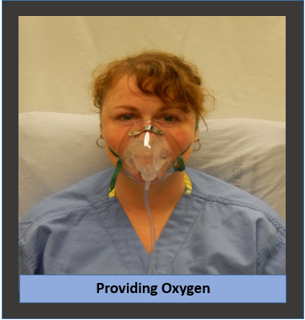
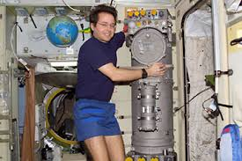

Making oxygen for breathing
There are several ways to make oxygen for breathing. Some of these can be used on the space station. Can use equipment or biological organisms.

Slide 3
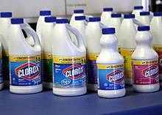
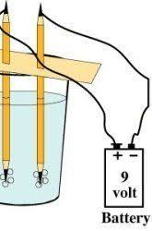
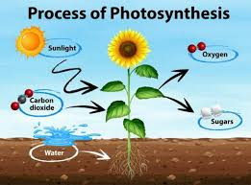
3 Methods of Making Oxygen
1. Chemical
2. Electrochemical
3. Biological

Slide 4
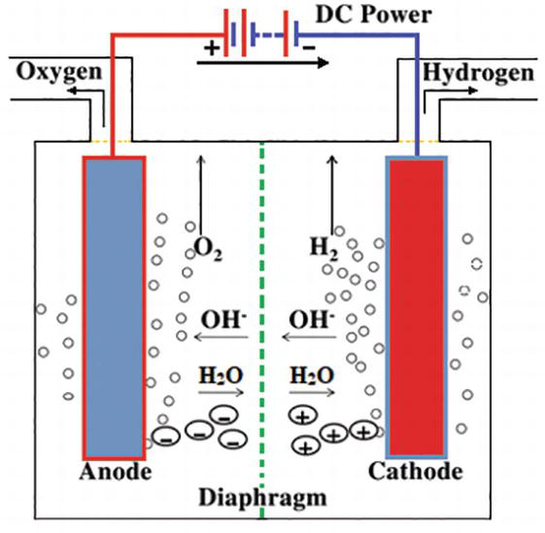
Electrochemical Generation
Electrolysis - The passage of an electric current through an electrolyte with subsequent migration of positively and negatively charged ions to the negative and positive electrodes. This results in the generation of gases such as oxygen and hydrogen at the electrodes.

Slide 5
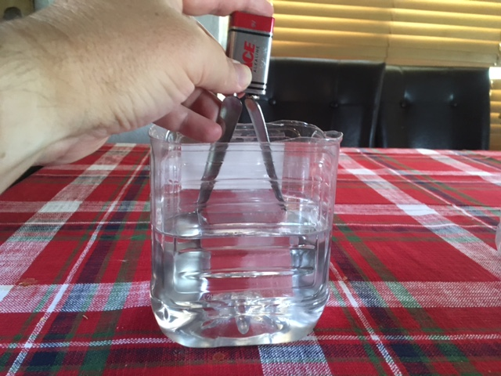
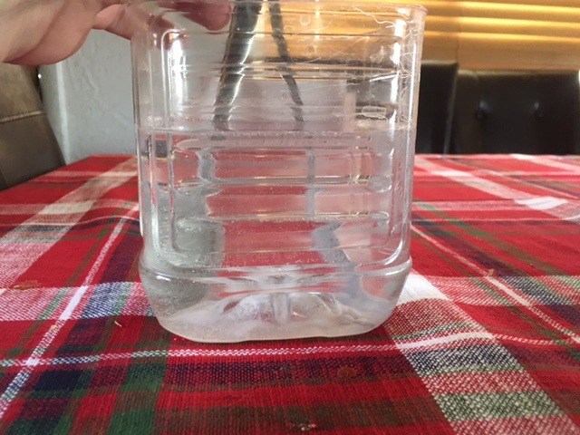
Importance of Electrolytes in Electrolysis
Electrolytes are required to generate gas bubbles at the electrodes. They transport the charges to the electrodes.
Electrolyte – A liquid that contains ions that carry electric charges.

Slide 6
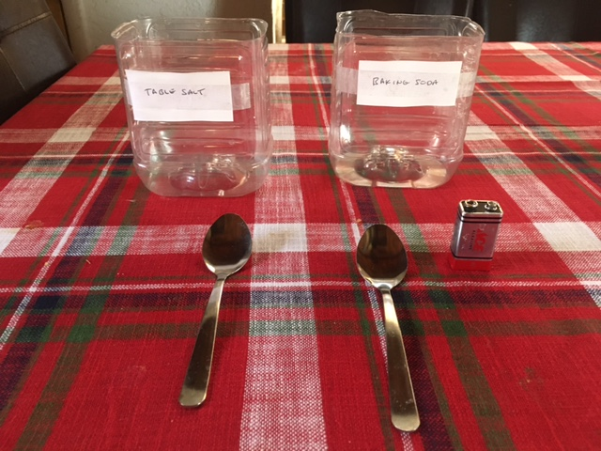
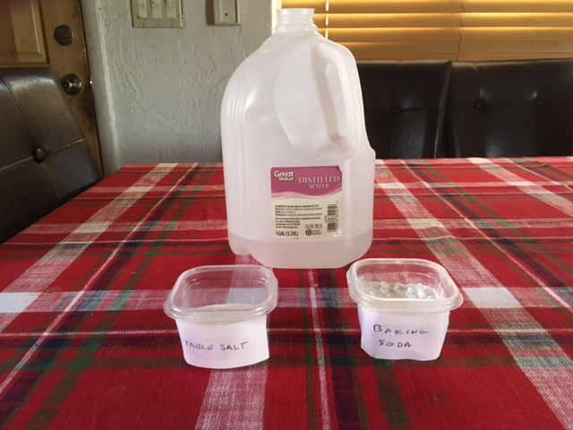
Creating your own Electrolysis unit
You can make your electrolysis experiment with simple equipment like two spoons, a 9V battery, an electrolyte and water.
Spoons serve as the two electrodes. Anode for Hydrogen. Cathode for oxygen.
Table salt and baking soda are a few types of Electrolytes.

Slide 7
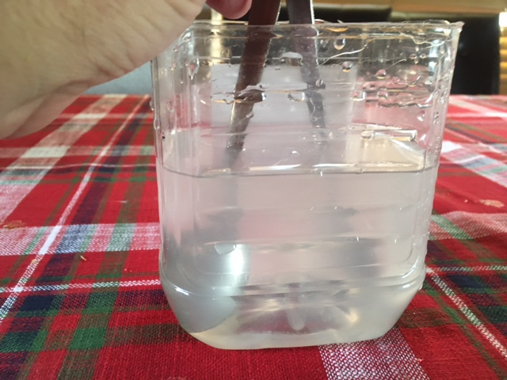
Doing the Electrolysis Experiment
Battery terminals must be touching both spoons, but the spoons cannot touch each other in the liquid. Bubbles should come off the spoons!
Add 1 cup of electrolyte to each container. Observe and then add a 2nd cup of electrolyte and see what happens. Mix electrolyte in well.
Will more or less gas bubbles be generated at the spoons if we add more electrolytes? Which electrode generates more bubbles?

Slide 8
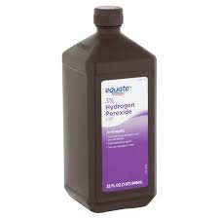

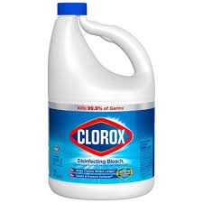
Chemical Generation of Oxygen
The mixture of two household chemicals that are liquids creates a reaction that forms oxygen. (Oxygen bubbles are created)
CHEMICAL REACTION
Bleach + Hydrogen Peroxide Salt + Water + Oxygen

Slide 9
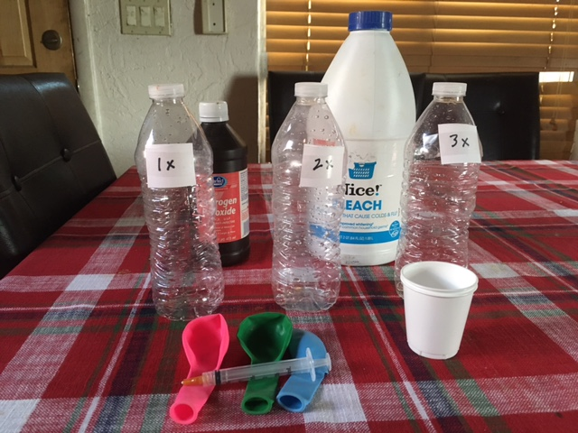
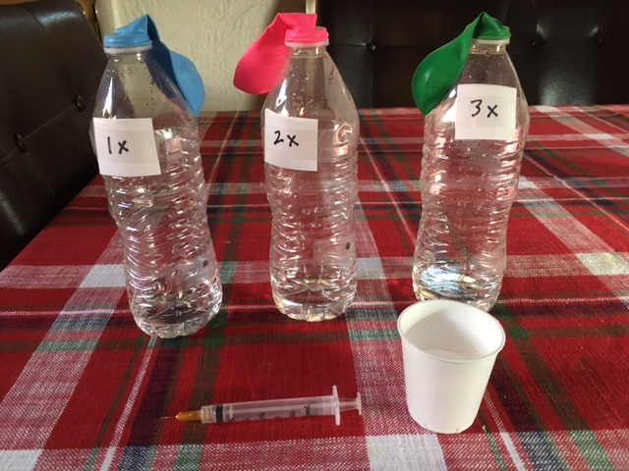
Making oxygen from bleach and peroxide
Experiment with 3 bottles that contain hydrogen peroxide.
Add bleach to each one with a syringe. Put a balloon on top.
Each bottle has 1x , 2x and 3x amount of bleach.
Does the 3x produce more gas than the 2x?

Slide 10
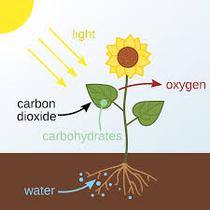
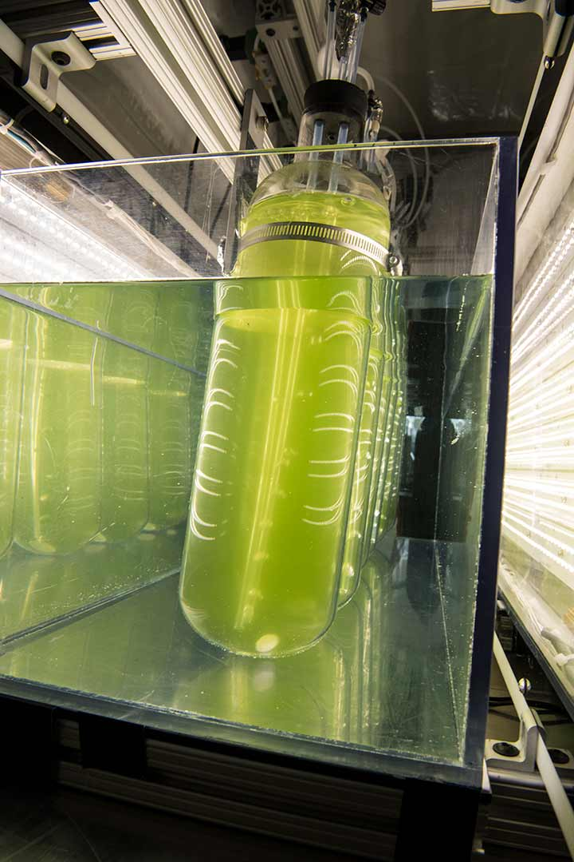
Creating oxygen from Photosynthesis
The process of photosynthesis produces sugar and oxygen from carbon dioxide and water.
PHOTOSYNTHESIS
Carbon Dioxide + Water Glucose + Oxygen

Slide 11

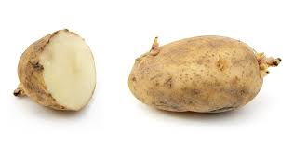
Creating oxygen from enzymes
The enzyme Catalase reacts with hydrogen peroxide to produce water and oxygen. Enzymes are ‘living proteins’ that facilitate reactions.
Catalase is found in living organisms like potatoes.
CATALASE
Hydrogen Peroxide Water + Oxygen
H₂O₂ H₂O₂ H₂O + O₂

Slide 12
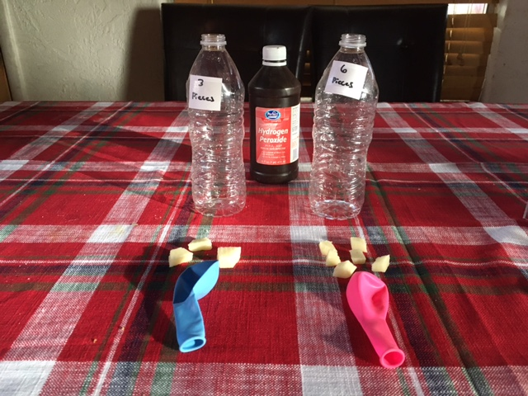
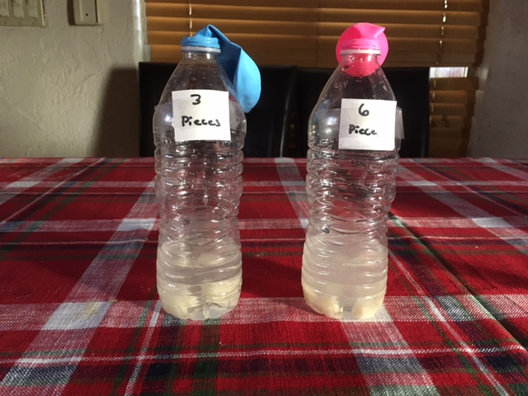
Potato – Catalase Experiment
Need cut potato pieces. 3 regular pieces. 6 smaller pieces.
2 500 mL bottles with hydrogen peroxide, covered with balloons.
Put pieces into bottles and cover mouth with balloons.
Which bottle will produce more oxygen gas to fill the balloon?

